Slide 1
Engagement Communication

Slide 2
What We’ll Talk About
Engage employees to make great organizations
Foundations:
5 BIG takeaways from more than 60 years of research
Action:
What you can do, now

Slide 3
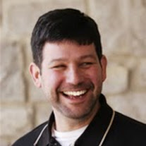
About Jake
Started my career as a wildlife biologist
Found organizations to be ecosystems
Now I work on: Developing employees’ leadership skills so that they can accomplish important missions

Slide 4
Foundations
Engagement science from A-Z

Slide 5
Dispelling Myths
Myth: Resources are limited, so I cannot do much
Reality: Engaging your employees is FREE
Myth: My leaders make it so I cannot engage my staff
Reality: You are the captain of your own ship
Myth: Engagement is just a check-the-box exercise
Reality: It’s about an emotional connection to work

Slide 6
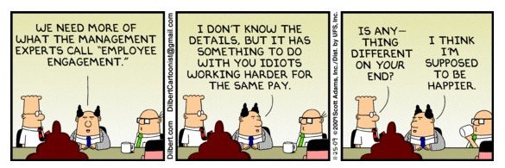
What is engagement?
Discretionary effort

Slide 7
Engagement: a better view
Willingness to give discretionary effort (classic definition)
“…the employees' sense of purpose that is evident in their display of dedication, persistence, and effort in their work and overall attachment to their organization and its mission.” (Donovan, Cobert, Archuleta, & McLaughlin, 2014)
“Say, Stay, and Strive” (Emerge Leadership Group, 2010)

Slide 8
What Are the Ingredients?
Meaningful work
Clear expectations
Resources (just enough, not too much)
Opportunities to improve
Mutual trust and fair treatment
Understanding of role in the bigger picture
Adapted from Ken Blanchard and Company

Slide 9
Engagement Looks Like…
Messy
(Occasionally) Chaotic
Emotional
Rewarding
Productive
Gratifying

Slide 10
The Big Assumptions
You want to be a more engaging leader
You want to increase value to your agency
You are engaged or willing to change
“Managers have the greatest impact on employee engagement…: A strikingly low percentage -- just 35% -- of U.S. managers are themselves engaged, while 51% are not engaged and 14% are actively disengaged.”
Gallup Organization, April 2, 2015

Slide 11
Engaged Managers: Gallup
Just 35% of MANAGERS in the US are engaged, and 51% are “checked out”.
Managers are 39% more likely to be engaged when their supervisors are not actively disengaged.

Slide 12
Engaged Employees: Gallup
Employees are 59% more likely to be engaged when their supervisors are not actively disengaged.

Slide 13
Ladder of Inference - Argyris
Take Action
Adopt Beliefs
Draw Conclusions
Make Assumptions
Add Meaning
Select Data
Observe Data

Slide 14
Big Takeaway #1:
Don’t jump to conclusions about people and circumstance.

Slide 15
Hawthorne Experiments - Mayo
Productivity
Time
Increase Light - Expected
Increase Light - Actual
Decrease Light - Expected
Decrease Light - Actual

Slide 16
Big Takeaway #2
Employees are more responsive when they believe that their managers care.

Slide 17
Two-Factor Motivation - Herzberg
Hygiene Factors
Extrinsic
Lead to Dissatisfaction
Policies
Supervision
Motivators
Intrinsic
Lead to Satisfaction
Achievement
Recognition
Work Itself
Work Conditions
Salary
Peer relationship
Responsibility
Advancement
Growth
Relationship w/Supervisor

Slide 18
Big Takeaway #3
First, stop demotivating employees.

Slide 19
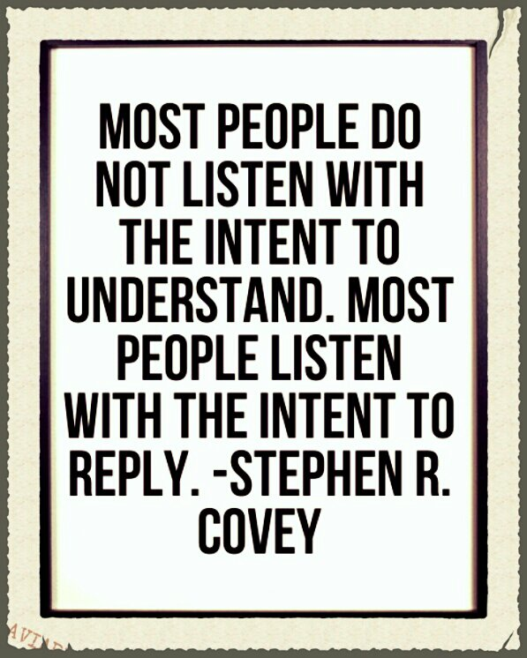
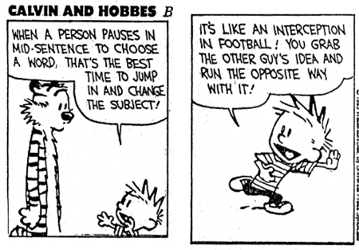
Interdependence - Covey
“Interdependence is the paradigm of we – we can do it; we can cooperate; we can combine our talents…to create something greater together.” Stephen R. Covey
“Interdependence is the paradigm of we – we can do it; we can cooperate; we can combine our talents…to create something greater together.” Stephen R. Covey
Think Win-Win
and
Seek first to understand,
then be understood
Notes:
Think Win-Win is a mindset. Approach the world looking for ways to have both parties get an advantage. It is also OK to have a “No Deal”
Quick Poll – How many people have training in listening?
What do you really mean when you tell someone, “I hear you.”? Is it followed by “but” or “and”
Empathy is key: ALWAYS let people know you’re listening by building on their thought. That’s not the same as agreement.
Be empathetic. State the emotion, then paraphrase what they said. Paraphrasing let’s them know that acknowledge how they’re feeling and if you can put their statement in your own words, you understand their point.
Mention “I” statements

Slide 20
Big Takeaway #4:
Empathy is critical to meaningful human relationships.

Slide 21
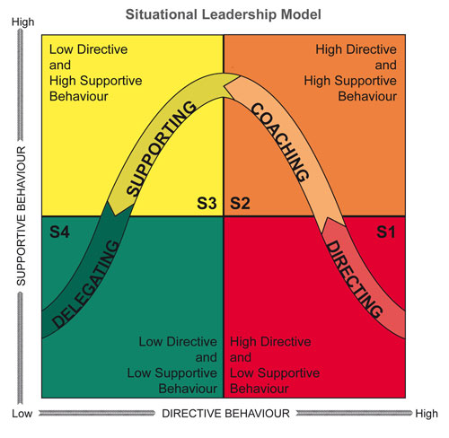
Situational Leadership
Describe the task.
Diagnose development level.
Agree on leadership style.

Slide 22
Big takeaway #5
Change your management style to meet each employee’s needs.

Slide 23
Action
Six principles you can apply today…
…without additional training

Slide 24
Intent over Technique
Do you really want engagement, or the appearance of engagement?

Slide 25
Trust: Align Hidden and Visible Agendas

Slide 26
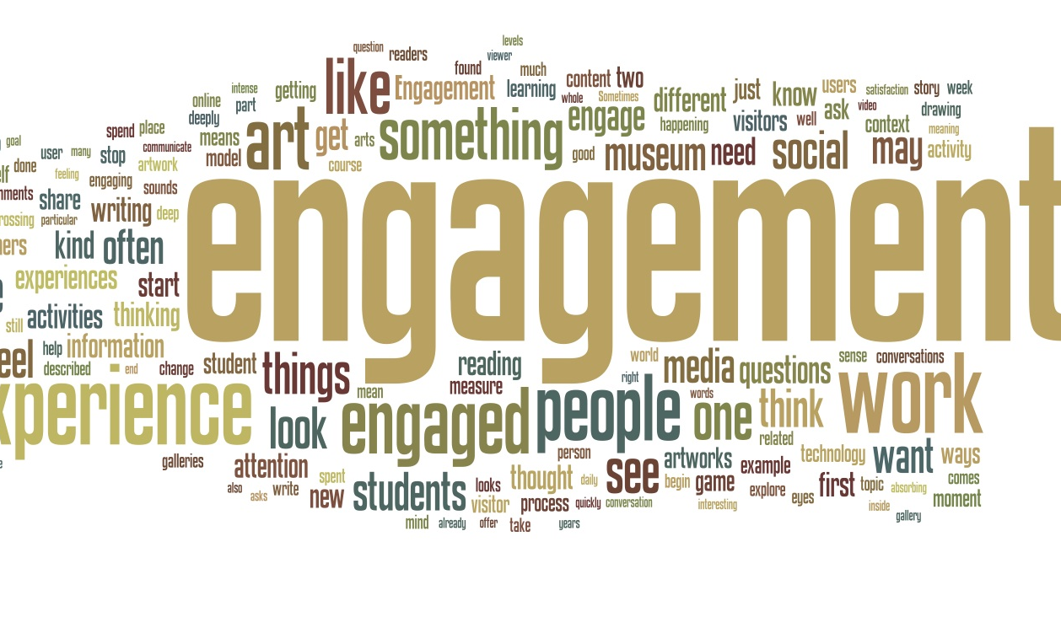
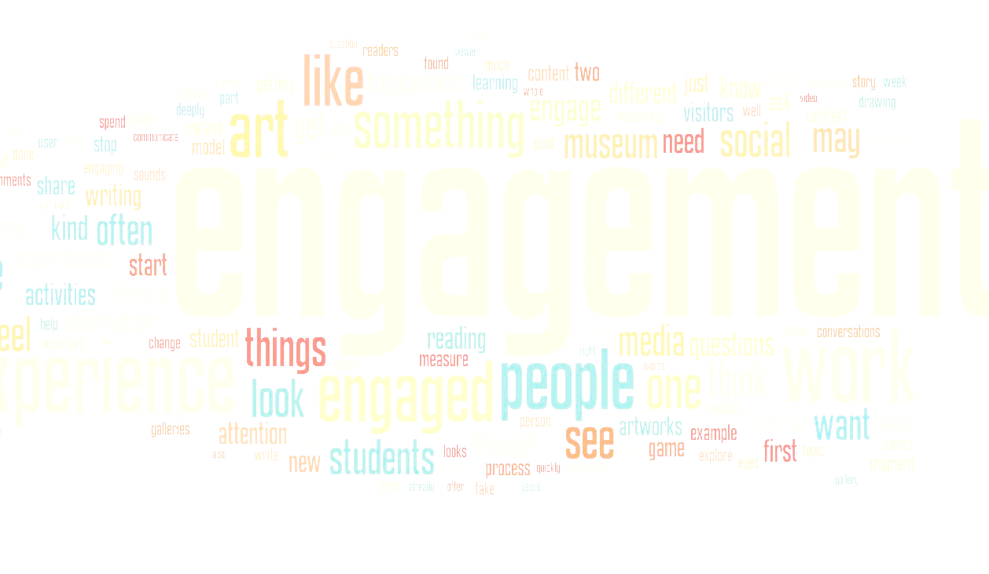
Be Engaged – Unfailingly Positive
Do you say good things about:
Your organization?
Your leaders?
Realistic - Not Pollyanna:
Stick to the facts – be objective
Don’t complain; make things right
Notes:
If you’re not engaged, your employees won’t be either.

Slide 27
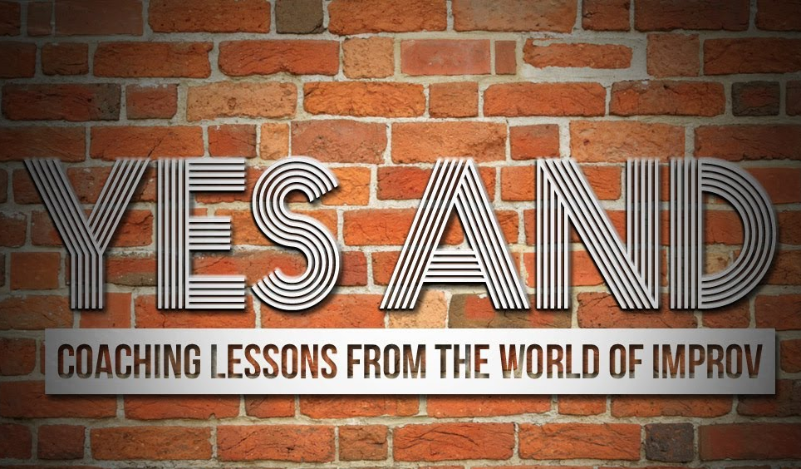
Respond: “Yes, AND”
“Yes, and” = “Yes”
“Yes, but” = “No”
Notes:
Build on an idea. Don’t judge the initial idea, instead look for the positive.

Slide 28
Stop!
Overvaluing your importance
Making your employees’ decisions
Putting people down (when they’re not around)
Setting low expectations
Punishing failure
Notes:
Often it is less about what you do, and it’s more important on what you need to stop doing.
Typically, people don’t realize their detrimental behaviors.

Slide 29
Empower Your Employees
Notes:
Nordstrom example from “Built to last”
Think of accountability as an empowerment tool.
Might mean challenging people

Slide 30
Closing

Slide 31
Quick Review - Background
Ladder of Inference
Hawthorne Experiments
Two-factor Motivation
Interdependence
Situational Leadership

Slide 32
Review - Action
Intent over technique
Build trust
Align hidden and visible agendas
Be unfailingly positive
Respond “Yes, AND”
Stop! (doing disengaging behaviors)
Empower your employees

Slide 33
Questions?

