Slide 1
Diversity Recruitment and Understanding Your Data
Using Data for Cultural Transformation
Presented by
Dr. Zina B. Sutch
Director, Diversity, Recruitment, and Work Life, USDA

Slide 2
Using Data to Improve Hiring, Diversity and Inclusion
Under the leadership of Secretary Vilsack, USDA has implemented the Cultural Transformation initiative to drive workplace improvements and improve mission delivery for USDA’s seven Mission Areas, 17 Agencies, and multiple Staff Offices

Slide 3
Using Data to Improve Hiring, Diversity and Inclusion
The goal of USDA’s Cultural Transformation is to ensure that every customer and employee is treated with dignity and respect, and given the opportunity to succeed
Cultural Transformation encompasses workplace improvements including hiring, diversity and inclusion with a business case for becoming a model workplace with a high performing workforce

Slide 4
Using Data to Improve Hiring, Diversity and Inclusion
USDA established a Diversity/Transformation Council of senior leaders that meets monthly to set goals, share best practices and track progress toward workplace improvements
Our Cultural Transformation Action Plan is established annually and adjusted periodically as needed
Mission Area, Agency, and Staff Office data is collected and reported monthly to the Secretary and top level leaders

Slide 5
Using Data to Improve Hiring, Diversity and Inclusion
The Cultural Transformation Milestones and Metrics Annual Performance Appraisal reflects annual performance based on documented results over the fiscal year
Monthly, mid-year, and annual reports are provided for our Secretary, Mission Areas, Agencies, and Staff Offices

Slide 6
Using Data to Improve Hiring, Diversity and Inclusion
The Cultural Transformation Milestones and Metrics results have been incorporated into the performance standards of all executives, managers, and supervisors
The results show that: “What gets measured gets done”

Slide 7
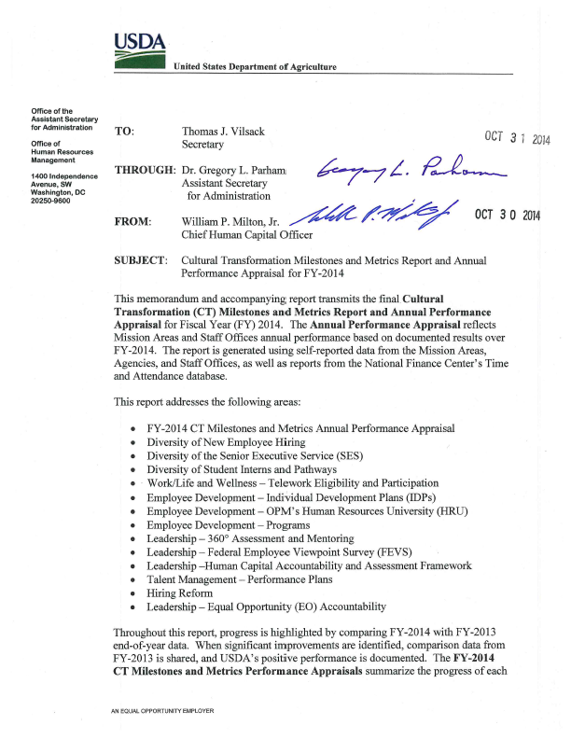
Using Data to Improve Hiring, Diversity and Inclusion
Diversity Workforce Demographics
SES Diversity Demographics
Student Intern and Pathways Demographics
Disability Hiring
Veteran Hiring
Training on hiring, diversity and inclusion

Slide 8
Using Data to Improve Hiring, Diversity and Inclusion
To support our efforts, we have taken the following steps:
Issued guidance to HR professionals and hiring managers on the effective use of hiring flexibilities
Established partnerships with employee organizations and affinity groups
Developed a strategic plan – the USDA Diversity and Inclusion Roadmap

Slide 9
Using Data to Improve Hiring, Diversity and Inclusion
To support our efforts, we have taken the following steps:
Required training on hiring reform and diversity inclusion for HR professionals, hiring managers, new supervisors, and all employees
Compared our monthly progress with hiring to the Civilian Labor Force
Shared our successes in the monthly all-USDA employee newsletter, MyUSDA

Slide 10
Using Data to Improve Hiring, Diversity and Inclusion
Highlights of Results:
Percentage of minorities in the SES from 2009 to present is up by 93% with 36.7% of SES being a minority, the most diverse in the Federal government
Percent of women in the SES is up by 41% for this time frame with 38.8% of SES being female
SES Candidate Development Program is 39.6% minorities, ensuring a diverse and talented pipeline of individuals prepared for leadership positions

Slide 11
Using Data to Improve Hiring, Diversity and Inclusion
Highlights of Results:
Improved the diversity of USDA’s workforce so that we more closely reflect the America we serve where 27.22% of our employees are minorities
Exceeded the Civilian Labor Force in six out of ten diversity demographic categories, and making progress in the other 4

Slide 12
Using Data to Improve Hiring, Diversity and Inclusion
Highlights of Results:
Compared to 2011, Hispanic employment has increased by 35%; Asian Americans have increased by 34%, African Americans have increased by 31%, and 2 or more races have increase by 87%
The Secretary incorporated gender identity and gender expression in the Department’s non-discrimination policy statement

Slide 13
Using Data to Improve Hiring, Diversity and Inclusion
Highlights of Results:
Improved Veteran hiring from only 5% in 2010 to 12% by the end of FY 2015
Approximately 30% of all our permanent new hires have been Veterans
Results are presented to National Labor Forum regularly -- union has members on Diversity & Transformation Council

Slide 14
Using Data to Improve Hiring, Diversity and Inclusion
Highlights of Results:
For student hiring, exceeded the USDA FY-2014 baseline - met or exceeded the Civilian Labor Force in 9 out of 10 diversity demographic categories
Increased minority students hired from 19.77% in 2011 to 38.5%
Increased Veteran students from 6% in 2010 to 22%

Slide 15
Using Data to Improve Hiring, Diversity and Inclusion
Highlights of Results:
USDA has been recognized by employee organizations and affinity groups with numerous awards for supporting diversity and inclusion
USDA improved from 5 to 3 out of 37 large agencies in Support for Diversity in the 2015 Best Places to Work Rankings

Slide 16
Using Data to Improve Hiring, Diversity and Inclusion
Highlights of Results:
USDA improved in overall Best Places to Work rankings:
2013: 16 out of 19 Large Agencies
2014: 13 out of 19 Large Agencies
2015: 11 out of 19 Large Agencies

Slide 17
Using Data to Improve Hiring, Diversity and Inclusion
Recommendation: Incorporating goals and metrics on hiring, diversity and inclusion into your planning efforts will provide you the opportunity to:
Institutionalize goals and measurements into workforce and succession related planning;
Track, monitor, and hold yourself and your team accountable for mission improvements; and
Analyze progress to make future decisions

Slide 18
Contact Information
Thank You!

