Slide 1
UnlockTalent.gov
Rachel St. John

Slide 2
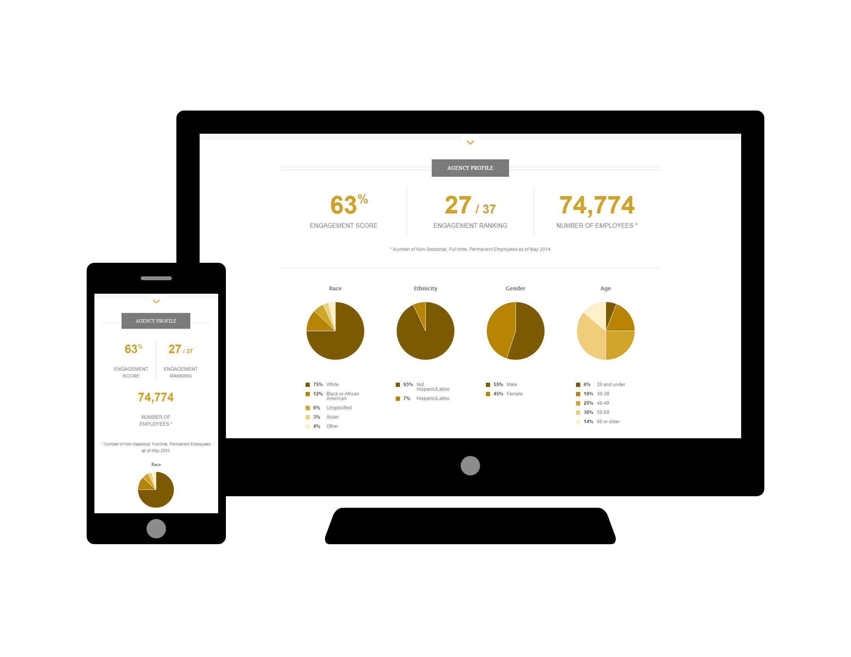
Unlocking Federal Talent

Slide 3
Goals
What is it?
Why did we build it?
What does it do?
What can you do with it?

Slide 4
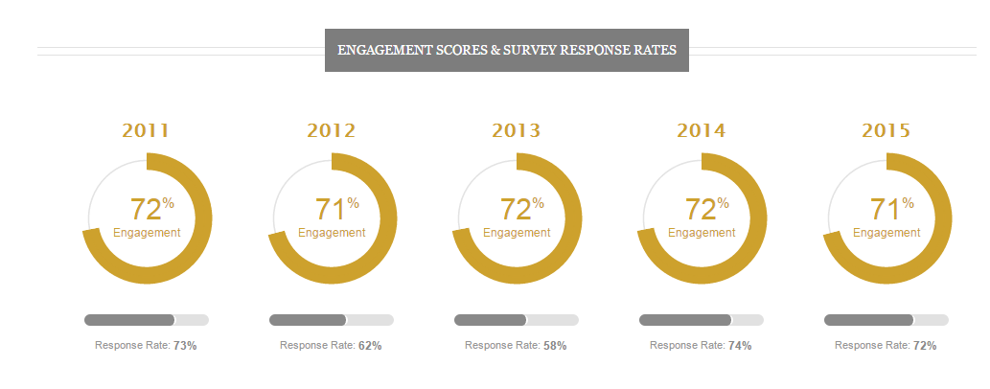
What Is Unlocking Federal Talent?
An interactive, web-based data tool for Federal agencies to drive data-driven decision-making to foster a culture of engagement

Slide 5
Why Did We Build It?
President’s Management Agenda: People & Culture
“Innovate by unlocking the full potential of the workforce we have today and building the workforce we need for tomorrow”
“Create a culture of excellence and engagement to enable higher performance”

Slide 6
Why Did We Build It?
Before:
Agencies had to access multiple data sets in multiple locations to even begin analyzing their workforce
Now with UnlockTalent.gov:
Combined data sources
Web-based with adaptive design
Customizable and scalable over time
Uses current data visualization techniques to bring the data to life

Slide 7
Milestones
Number of Users: Currently over 13,000 users on UnlockTalent.gov across 85 different Federal agencies & organizations
President Obama addressed the SES on UnlockTalent.gov: https://www.youtube.com/watch?v=2QErSrwKWck&feature=youtu.be&t=37m43sn

Slide 8
What Does It Do?
unlocktalent.gov

Slide 9
What Can You Do With It?
Make data-driven decisions
Tell a story through data, using it to write the next chapter
Create a culture of engagement by sharing the data and starting the conversation

Slide 10
Other Engagement Resources
OPM’s Manager Corner on HRU:
https://hru.gov/Studio_Managers/Studio_Managers_Corner.aspx
Maximizing Employee Engagement Online Course:
http://hru.gov/course_catalog.aspx?cid=185&mgr=true

Slide 11
References for Success
Leading America’s Workforce: https://www.youtube.com/watch?v=RobNCwqzJ4M
People & Culture Goal: http://www.performance.gov/node/3394/view?view=public#overview

Slide 12
Thank You!

