Slide 1
Bruce Stewart
Office of Diversity and Inclusion, OPM

Slide 2
Influence
https://www.youtube.com/watch?v=0JrWyfL7QUI

Slide 3
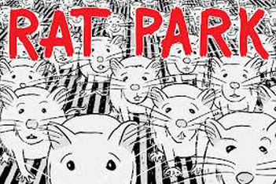

Slide 4
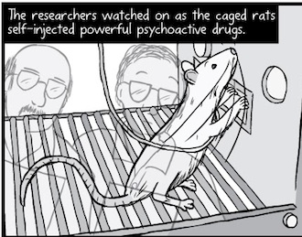

Slide 5
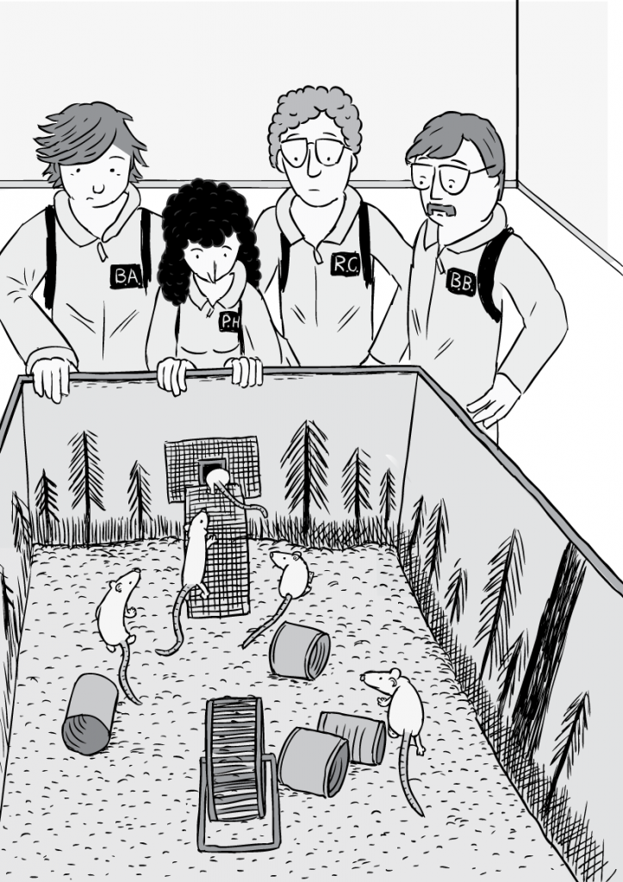

Slide 6
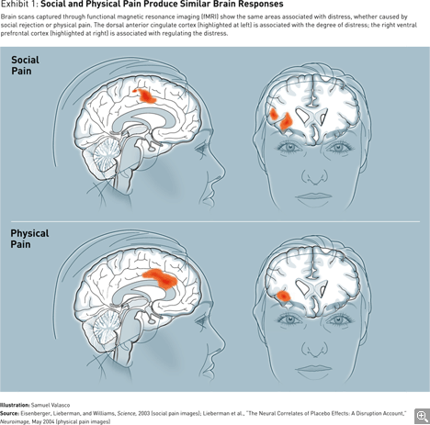
The “Real” Pain of Exclusion

Slide 7
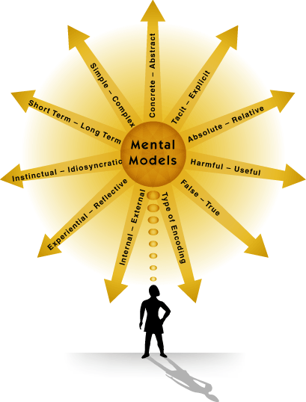
Wrong mental maps lead to wrong solutions which lead to lost resources…

Slide 8
The logic of diversity and inclusion
Diversity is not an imposition, it’s an advantage
Inclusion is not a problem, but it’s a solution
Working together is more than a good idea, it’s essential to individual and company success

Slide 9
The impact of D&I on people
57% increase in performance against goals
24% greater retention
21% more emotional commitment toward colleagues
11% increase in discretionary effort

Slide 10
The Heart of the Challenge
Exclusion generated through Unconscious Bias.
Accidental, subtle, unintended, and completely unconscious choices made by everyone all the time.
These actions result in exclusive systems, organizations, and interactions.

Slide 11
Cultural Hunt
Rule 1.
Get out of our Comfort Zone…

Slide 12
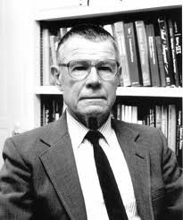
Thomas Schelling Segregation: background
In many (American) cities, races segregate
This has unwanted consequences
Why does this happen, and what can we do about it?
Main idea: this is because people don’t like each other
If that would be true, high-tolerance cities would have lower segregation than low-tolerance cities …
… but empirically this does not hold.

Slide 13
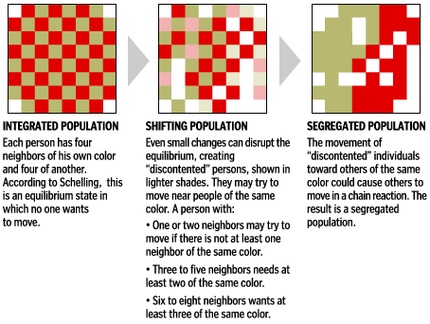

Slide 14
Schelling’s conclusion
Harsh preferences are not necessary to create segregation. In other words: ever under ‘mild’ circumstances, segregation can occur
And the simulation shows that segregation also depends on for instance how full the checkerboard is (if crowded, moving is more difficult)

Slide 15
Rule 2. Respect other Perspectives
Faces

Slide 16
Rule 3. We are Smarter Together
Innovation Quiz

Slide 17
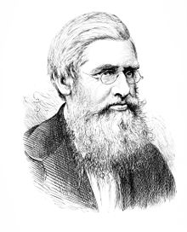
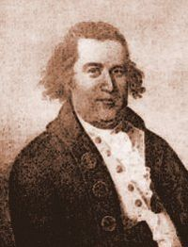
Why are these people not more Famous?
Claudette Colvin
Alfred Russell Wallace
William Dawes
Charles Darwin
Paul Revere
Rosa
Parks

Slide 18
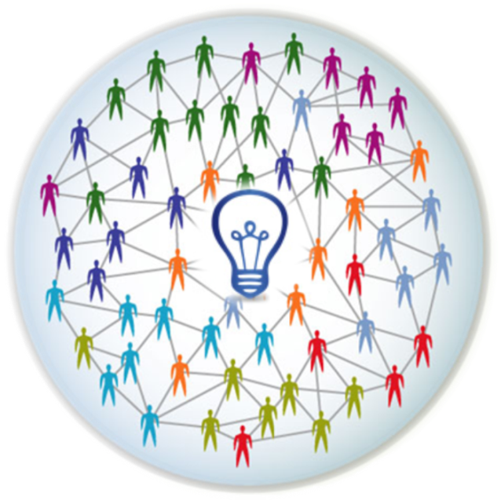
The New IQ = Inclusion Quotient
Measures
Inclusive Intelligence:
The intentional, deliberate, and proactive acts that increase work group intelligence by making people feel they “belong” and are “uniquely” valued.
The New IQ

Slide 19
In with the New and out with the Old…
Individual Smarts is less important
Old IQ
Group Smarts is most important
New IQ

Slide 20
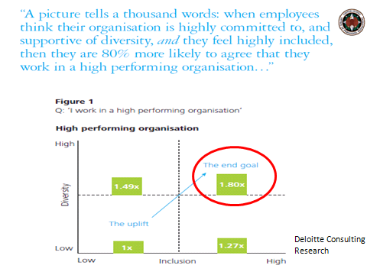
Research for example…
Conducted by Deloitte Australia

Slide 21
The Diversity Trumps Ability Theorem
The Difference
Mathematical truth
“collective ability equals individual ability plus diversity” and that diversity trumps ability”

Slide 22
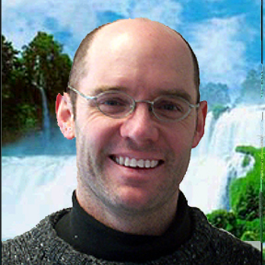
“Progress depends as much on our collective differences as it does on our individual IQ scores”
Scott Page

Slide 23
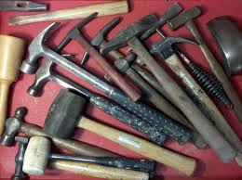
When all you have is hammers…

Slide 24
Everything looks like a nail…

Slide 25
We can do more with an assortment of tools…

Slide 26
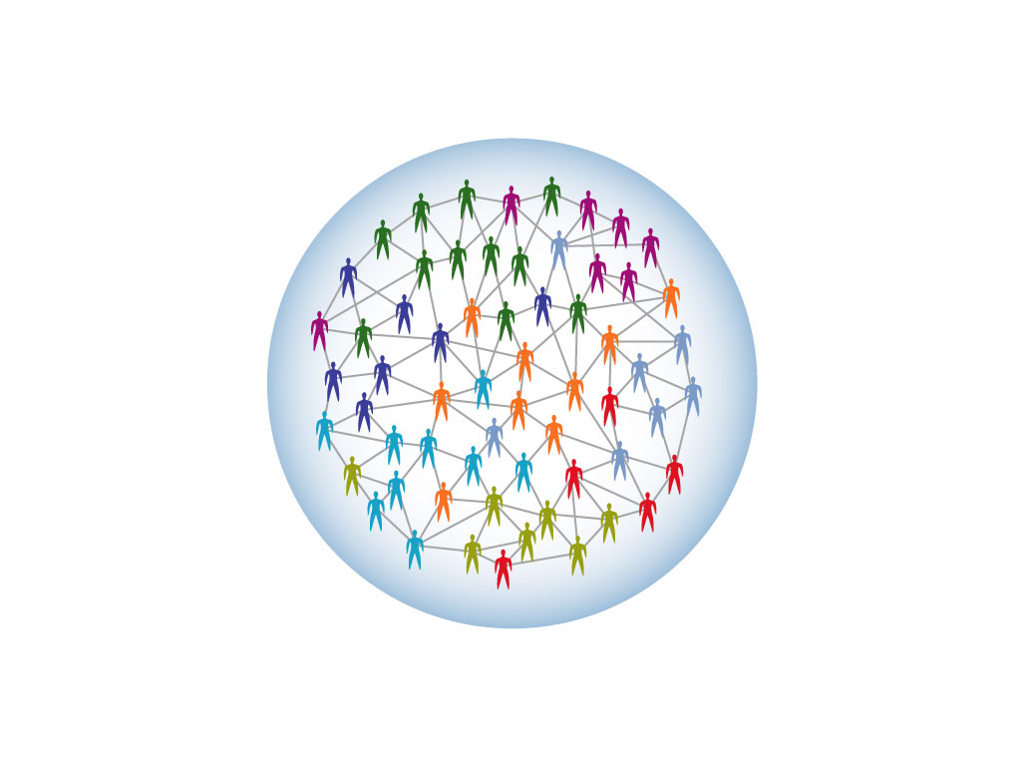
We are Smarter like this…
A stable, robust, high-performance system
Win
Win
Win
Win
Win
Win
Win
Win
Win
Win
Win
A Positive-Sum Game
An interactive networked organization
Win
Win
Win
Win
Win
Win
Win
Win
Win
Win
Win
Win
Win

Slide 27
We are less Smart like this…

Slide 28
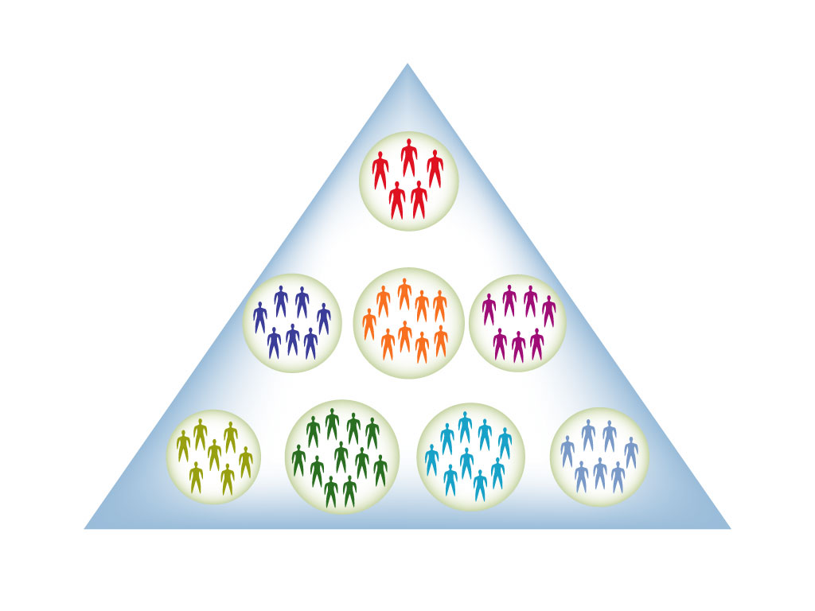
And even less Smart like this…
A fragile, unstable, low-performance system
A hierarchical segregated organization
A Zero-Sum Game

Slide 29
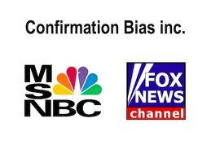
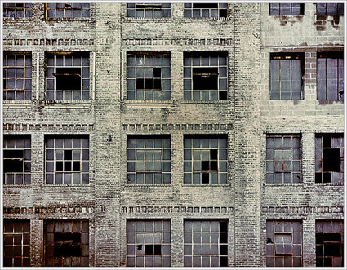
Social Biases that create silos and limit our potential…
“Like Me” Bias
“Confirmation” Bias
“Broken Windows” Bias

Slide 30
Bike Thief? The Riddle of Unconscious Biases…
https://www.youtube.com/watch?v=WNmCoHBJY2I

Slide 31
How do we get from here to there?
Our solution is a highly interconnected workforce where employees feel included, creative, and engaged…The New IQ
Our biggest challenge is disengagement due to lack of inclusive behaviors exacerbated by cliques, silos, and unconscious biases
The New IQ

Slide 32
The New IQ Logic to change culture through behavior change
20 Behaviors
5 Habits
Culture Change
Inclusive Environment

Slide 33
The New IQ: 5 Inclusive Habits
Empowerment
Supportive
Cooperative
Open
Fair

Slide 34
The New IQ Perception Scan
Complete the following New IQ Inclusive Intelligence Perception Scan using a scale of 1-5 (never, rarely, sometimes, often, always)
 | Behavioral Statement | Score
1 | Others would say I do not tolerate arbitrary actions, personal favoritism and coercion for political purposes.
2 | Others would say I do not tolerate prohibited personnel practices.
3 | Others would say I take steps to deal with poor performers who cannot or will not improve.
4 | Others would say I recognize differences in performance in a meaningful way.
5 | Others would say I give out awards based on how well employees perform their jobs.
6 | Others would say I reward creativity and innovation.
7 | Others would say I actively support policies and programs that promote diversity and inclusion in the workplace.
8 | Others would say I am committed to a workforce representative of all segments of society.
9 | Others would say I work well with employees of different backgrounds.
10 | Others would say I actively promote communication among different work units.
11 | Others would say I actively support collaboration across work units to accomplish work objectives.
12 | Others would say I actively support the needs of Others to balance work and other life issues.
13 | Others would say I regularly provide my subordinates with constructive suggestions to improve their job performance.
14 | Others would say I make time to listen to what they have to say.
15 | Others would say that I treat them with respect.
16 | In the last six months, Others would say I have talked with them about their performance.
17 | Others who depend on me would say they have enough information to do their job well
18 | Others would say I encourage them to come up with new and better ways of doing things.
19 | Others would say their talents are used well in the workplace.
20 | Others have a feeling of personal empowerment with respect to work processes.
Notes:
D&I are also fostered by having Openness as a way of doing business. In an open work environment, creativity and innovation are rewarded, policies and programs promote diversity in the workplace and supervisors and team leaders are committed to a workforce drawn from all segments of society as they work well with employees of different backgrounds
In a Cooperative work environment, managers promote communication among different work units to support collaboration across work units to accomplish work objectives.
When supervisors are Supportive, it means that supervisors support the need to balance work and other life issues. Supervisors and team leaders have to provide employees with construction suggestions to improve their job performance and talk with employees about their performance every 6 months. Supervisors and team leaders take the time to listen to what employees have to say and treat employees with respect.
The last FOCSE habit is Empowerment. In an inclusive workplace, employees have enough info to do their jobs and will feel encouraged to come up with new and better ways of doing things. In an empowered work setting, employees’ talents are well used and employees have a feeling of personal empowerment with regards to their work processes

Slide 35
New IQ Scores
Government Average
44% | 56% | 55% | 74% | 59%
Fair | Open | Cooperative | Supportive | Empowered

Slide 36
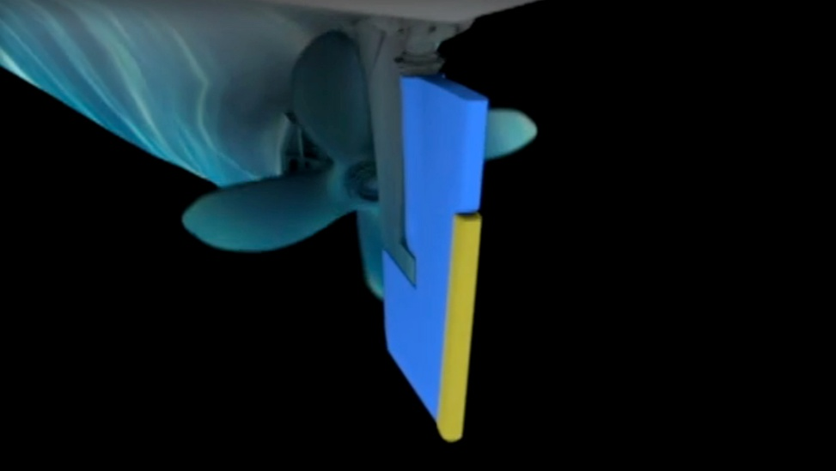
Becoming a Trim Tab at Work
Identify common themes
Using workbook write down examples from video
https://www.youtube.com/watch?v=HUqjlw1Zg5o
When thinking about “how can I possibly create change in my organization,” think of being a trim tab. Your small actions, your work in your circle of influence can create, over time, a big impact on your organization.

Slide 37
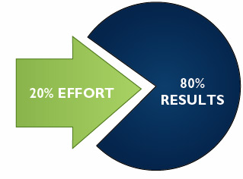
The 80/20 Rule

Slide 38
But First, Your Story…
Who: Who were your parents? Grandparents? History?
What: What were the 3 events growing up that impacted you the most?
When: When were you born? Generational memories
Where: Where were you born? Spent most of your time growing up? Memories?
How: How were you raised? Parents or Grandparents? Strict? Religious?
Why: In your opinion why do good or bad things happen to people?

Slide 39
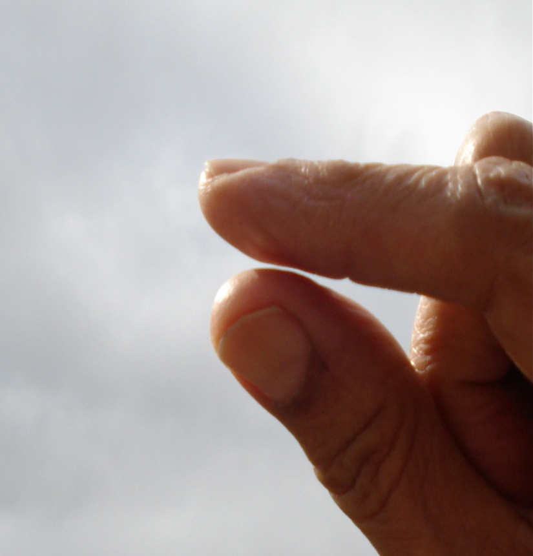
3 Small Steps to Creating Habits
1. Shrink the change
2. Find a spot
3. Train the cycle everyday
Shape your environment

Slide 43
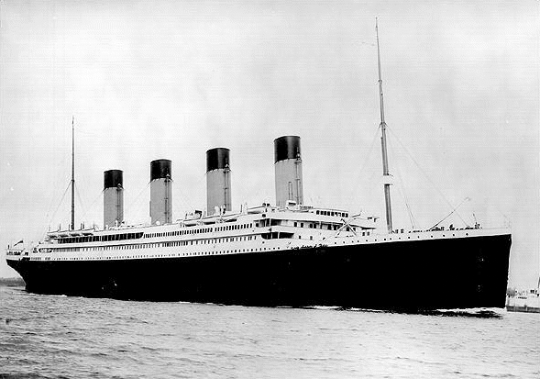
The Titanic

Slide 44
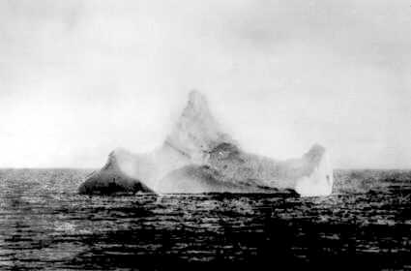
Newspapers from the time estimated the size of the iceberg to be between 50-100 feet high and 200-400 feet long. Titanic was navigable for awhile and could have pulled aside the iceberg. Many people could have climbed aboard it to find flat places to stay out of the water for the four hours before help arrived. Fixated on the fact that icebergs sink ships, people overlooked the size and shape of the iceberg (plus the fact that it would not sink).

Slide 45
If you do not intentionally, deliberately and proactively include, you will unintentionally exclude.

Slide 46
Susan Boyle
https://www.youtube.com/watch?v=jca_p_3FcWA

