Slide 1
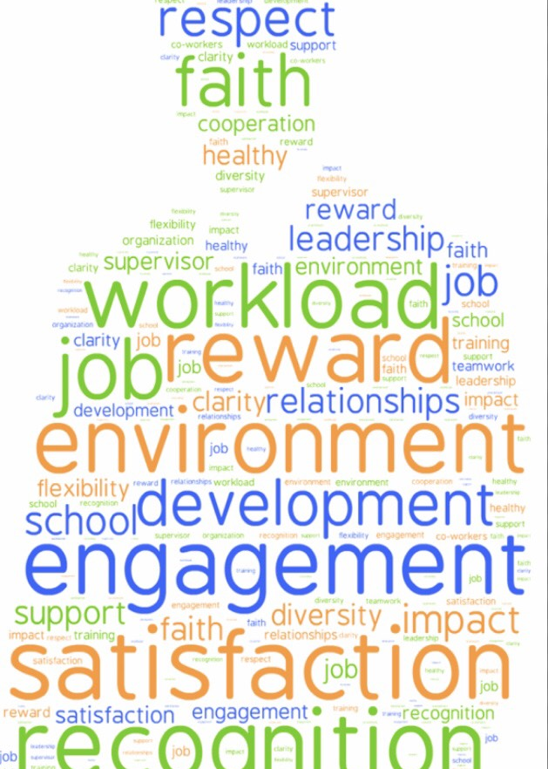
Empowering engaged leaders
Mika J. Cross
Federal Workplace Expert

Slide 2
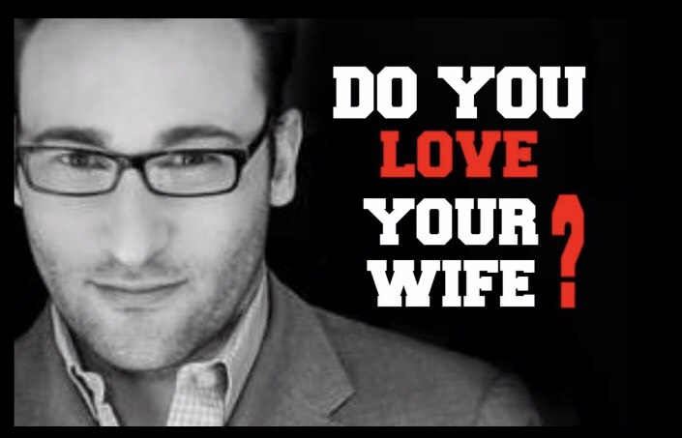
Creating an engaged Work culture
“If you really have a strong corporate culture, they will think of themselves like family, like brothers and sisters… “
How do you create brothers and sisters out of strangers?

Slide 3
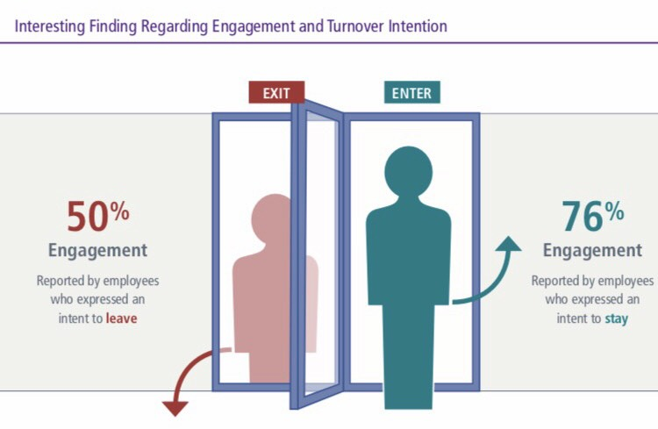
RETENTION OF TALENT

Slide 4
Building a modern, equal & inclusive workplace

Slide 5
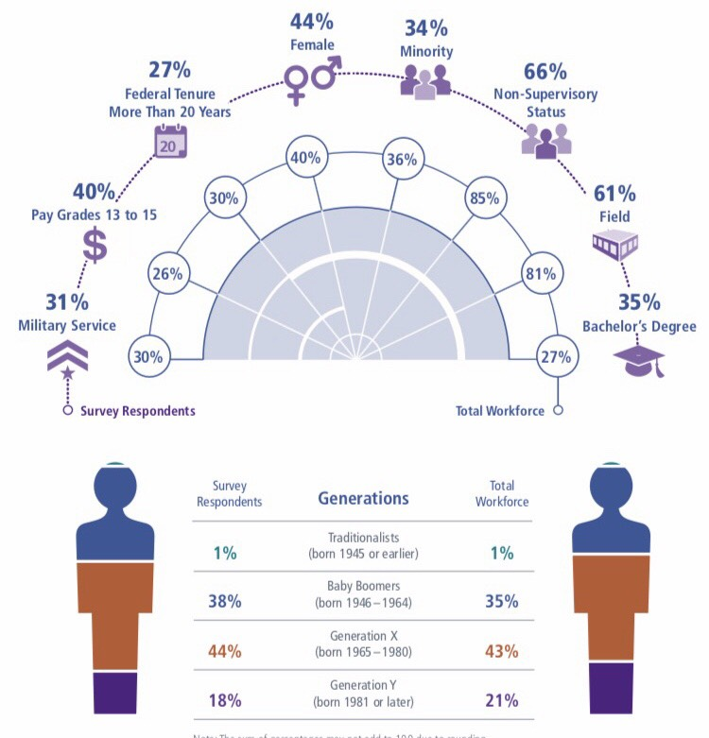
2018 FEVS snapshot

Slide 6
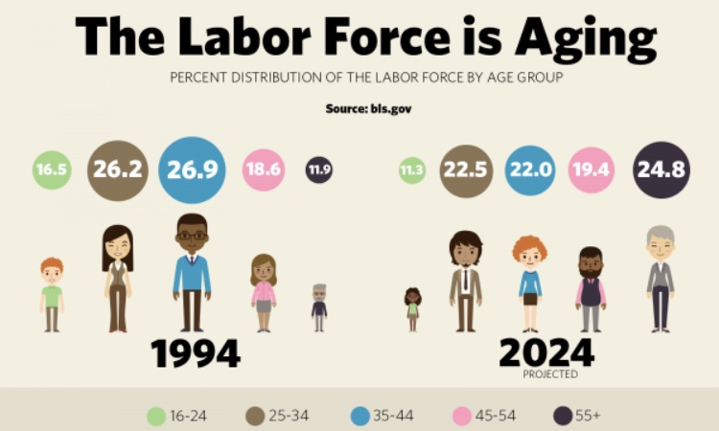

Slide 7
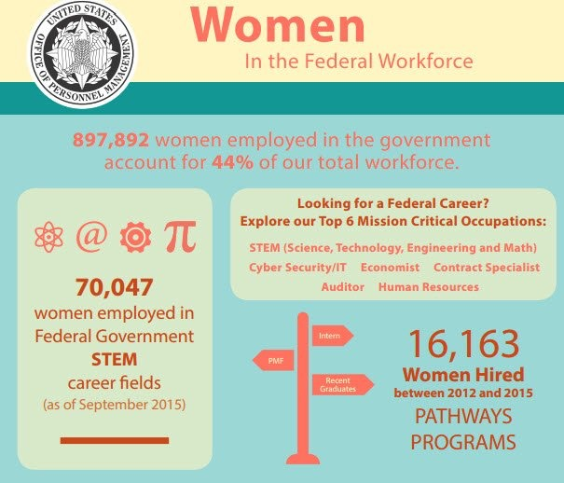
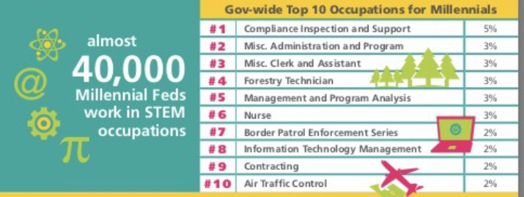
Future Federal workforce
Diversity through Inclusion> means mission efficacy
Enhanced Talent pipeline
Increased Retention
Ability to connect w/fellow customers

Slide 10
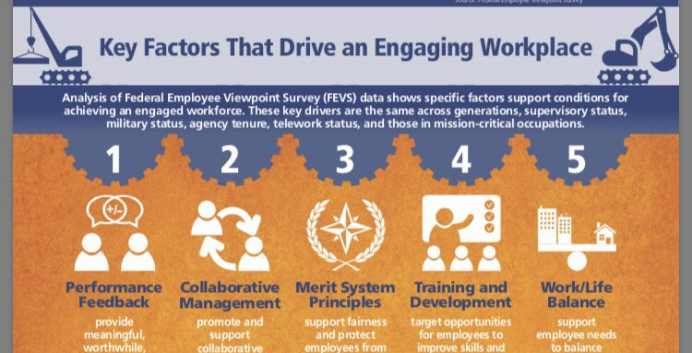

Slide 14
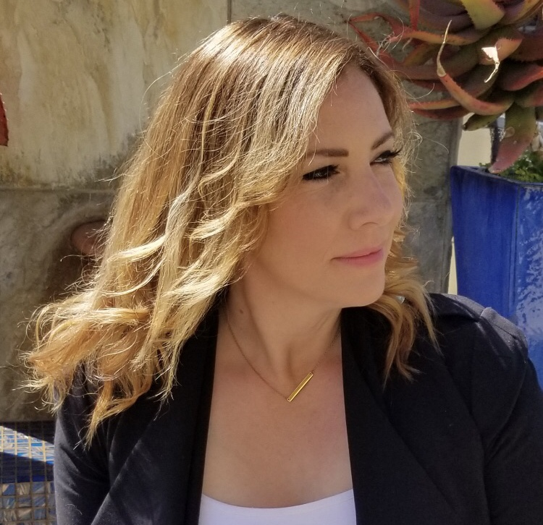
How to Connect
@Mika_Cross
LinkedIn Profile: https://www.linkedin.com/in/worklifechampionoftheuniverse/
mcross@flexjobs.com
Web Sites:
Flexjobs.com
Workflexibility.org
Remoteco.org

