Slide 1
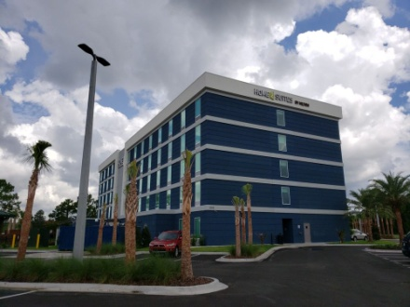
2019 Region 1 and 2 Conference
October 18 & 19 - Jacksonville, FL
Hosted by Chapters 11, 258, and 396
Home2 Suites
10715 Deerwood Park Blvd, Jacksonville, FL
https://home2suites3.hilton.com
$94 Room Rate (per night) plus tax
Reservations: Hilton Link http://home2suites.hilton.com/en/ht/groups/personalized/J/JAXSOHT-FMA-20191018/index.jhtml
Hotel Direct: (904) 638-0218 - Mention FMA Conference
Conference Fee $75. Send conference fee(s) along with attendee’s name, FMA Chapter and email address to FMA Chapter 396,
PO Box 17258, Fernandina Beach, FL 32035. Make Checks payable to “FMA Chapter 396”.
Email list of attendees to fmachp396@gmail.com
Fri: 3 - 6 p.m. Registration , 6 - 11 p.m. Social /Dinner (Hosted by Chapters 11/258/396)
Sat: 8 a.m. - 3 p.m. Conference and Training
Lunch Sponsored by GPIS
4 - 6 p.m. Team Building Event
Top Golf (Hosted by Region 2)

