Slide 1
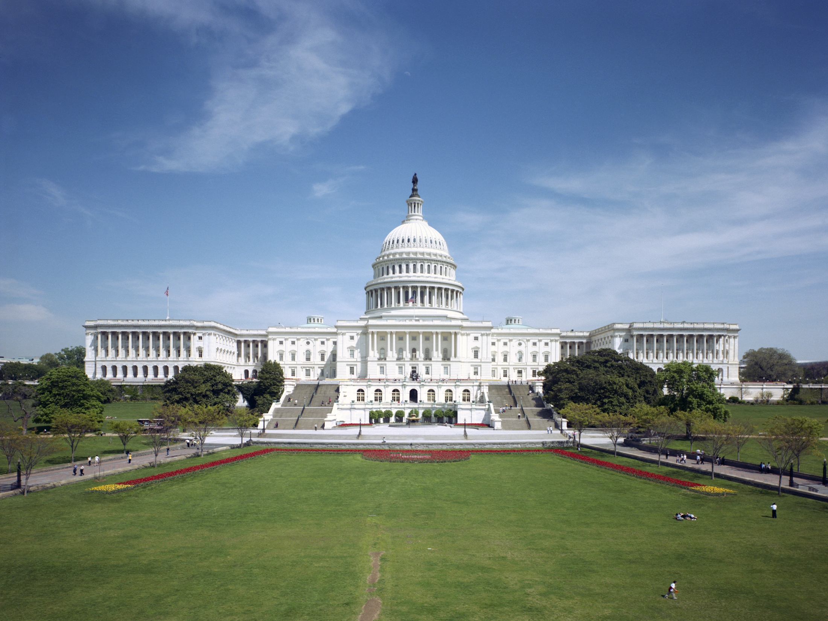
FEDERAL MANAGERS ASSOCIATION

Slide 2
Federal Managers Association Purpose:
To Advocate Excellence in Public Service
FMA represents the interests of the more than 200,000 managers, supervisors, and executives serving in more than 40 agencies of
today’s federal government.
Notes:
While membership is 10,000 we represent some 200,000 federal managers in public services.
We are structured in 8 geographical zones
We have an office in Alexandria, VA
Staff includes Director of Marketing and Recruitment
Legislative Director, Assistant to the Legislative Director and Grass Roots Coordinator
Membership coordinator and an Administrative Assistant.

Slide 3
Mission & Vision
Mission
Vision
FMA advocates excellence in public service through effective management and professionalism, as well as the active representation of its members' interests and concerns.
FMA advances its mission through consultation in the Executive Branch and advocacy in Congress, top-notch professional development programs, informative publications and networking opportunities for its members.

Slide 4
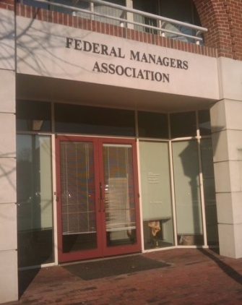
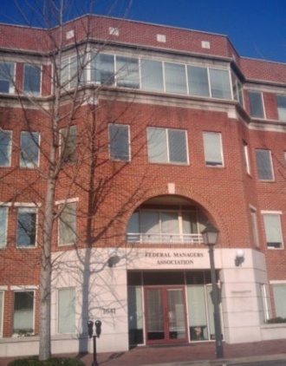
National Officers & Staff
The Executive Board consists of the National President, National Vice President, National Secretary, National Treasurer, Regional Directors and Executive Director
The National Office Staff consists of the Executive Director, Government & Public Affairs Director, Government Affairs/Communications Assistant, and
Finance & Administration Manager
FMA National Office:
1641 Prince Street
Alexandria, VA 22314
703-683-8700

Slide 5
Executive Board
President: Craig Carter
Vice President: Ron Gryga
Secretary: Pauline Coleman-Sutton
Treasurer: Christine Parker
Region 1 Director: Chris Lombardi
Region 2 Director: Linda Lentjes
Region 3 Director: Peggy Hatcher
Region 4 Director: Vincent Stamper
Executive Director: Todd Wells

Slide 6
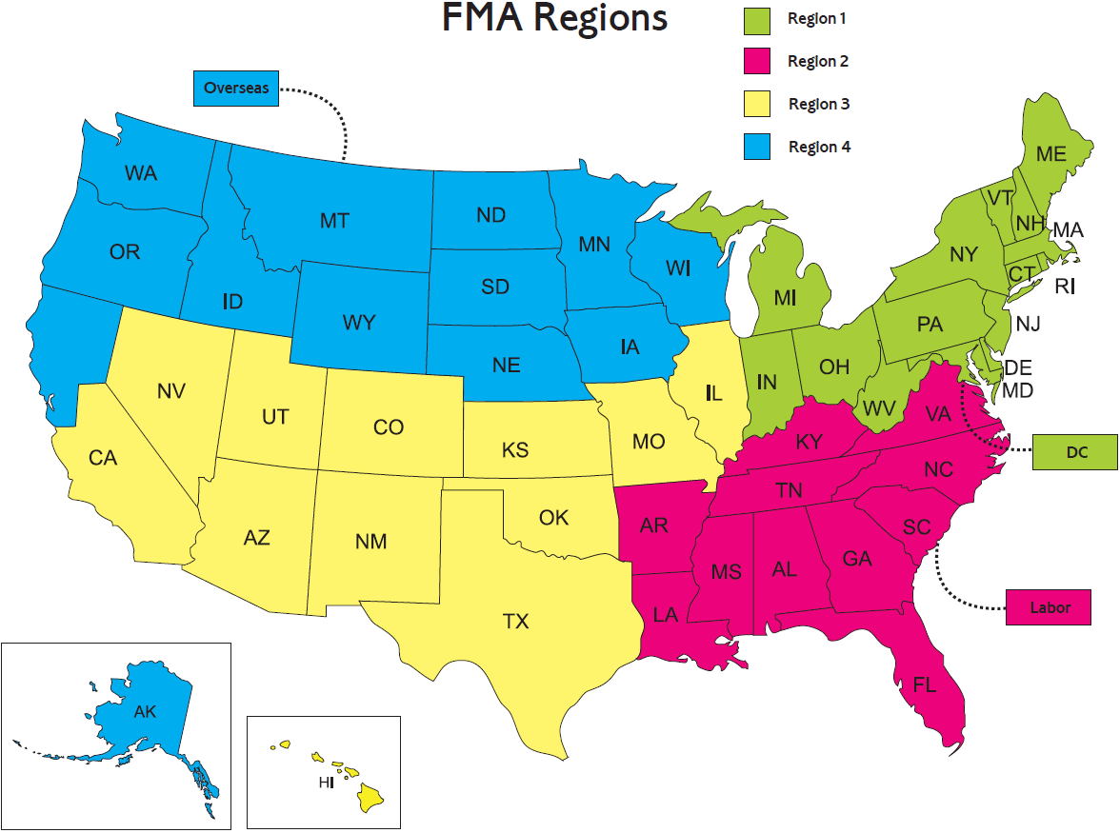

Slide 7
Advocacy in DC
Meet with Members of Congress and their Staffs
Attend hearings that affect federal managers
Meet with leaders of government agencies to influence policy
Work with other federal advocacy groups to strengthen our voice

Slide 8
Agency Representation
Department of Defense
Department of Commerce
Department of Energy
Department of Homeland Security
Department of Labor
Department of Transportation
Department of
the Treasury
Department of Veterans Affairs
Department of Health and Human Services
Independent Agencies
Ex. Social Security – OPM - GSA
Agencies are represented at the annual National Convention, Regional Conferences, and local Chapter meetings.

Slide 9
Community Partnerships
Government Managers Coalition (GMC)
Federal-Postal Coalition (FPC)
Federal Employee Education & Assistance Fund (FEEA)
Employee Thrift Advisory Council (ETAC)
National Active and Retired Federal Employees (NARFE)
National Commission on the Public Service
Partnership for Public Service
National Academy of Public Administration (NAPA)
Young Government Leaders
FMA maintains ongoing dialogue with: U.S. Office of Personnel Management (OPM) and the White House Office of Management and Budget (OMB)

Slide 10
Legislative Accomplishments
Averted Pay Freeze in 2019 and 2020: FMA members helped persuade Congress to override the administration’s call for an across-the-board pay freeze in both 2019 and 2020. Federal employees instead received a 3.1 percent pay raise in 2020.
FERS Sick Leave Credit: Those enrolled in the Federal Employees Retirement System (FERS) receive an average of at least $500 a year for applying unused sick leave towards their retirement plan. FMA was the driving force behind this legislation that rewards feds for responsible use of leave.
Repeal of DOD Cuts to Long-Term TDY Per Diems: FMA worked tirelessly for nearly four years to repeal drastic cuts of as much as 45 percent to Department of Defense (DOD) long-term TDY per diems. As a result of our efforts, DOD may no longer reduce the employee per diem allowance based on the duration of the TDY assignment.
Preventing Cuts to Benefits: FMA stopped harmful proposals by Congress or included in the administration’s FY 2020 budget request that would have increased pension contributions for existing federal employees, eliminated the FERS COLA, reduced the CSRS COLA, shifted from the “High 3” to a “High 5,” or eliminated the FERS annuity supplement.
New Locality Pay Areas: FMA advocated for the designation of six new locality pay areas beginning in 2019. These designations positively impact nearly 72,000 employees in Birmingham, Alabama; Burlington, Vermont; Corpus Christi, Texas; Omaha, Nebraska; San Antonio, Texas; and, Virginia Beach/Norfolk, Virginia.

Slide 11
Legislative Accomplishments
Paid Parental Leave: FMA supported the successful effort to provide 12 weeks of paid parental leave for new mothers and fathers (by birth, adoption, or foster) of a child. Legislation included in the FY 2020 National Defense Authorization Act (NDAA).
Wounded Warriors Federal Leave Act: Thanks to FMA, new feds with a service-connected disability will begin their career with 104 hours of additional sick leave to use for their disability-related appointments and treatment during their first year as federal employees. In addition to the legislative action, FMA worked with rule makers at the Office of Personnel Management (OPM) who drafted exemplary rules for implementation.
Allowing Feds in Reserves an opportunity to enroll in the health plan of choice: FMA advocated for the TRICARE Reserve Select Improvement Act, which allows feds in the reserves or National Guard to enroll in this plan, like their non-fed counterparts, if they choose. Language included in the FY 2020 NDAA.
Protect the 2-Year Probationary Period at DOD: FMA successfully revised House-passed language that would have changed the probationary period at DOD from two years to one year. NDAA requires a study to assess the current probationary period.

Slide 12
Legislative Accomplishments
FEHBP Self Plus One: In the Bipartisan Budget Plan (P.L. 113-67), Members of Congress called for the Office of Personnel Management to offer a “Self Plus One” option to federal employees enrolled in the Federal Employees Health Benefits Program (FEHBP). FMA long advocated for this option, as it would immediately reduce federal spending and provide affordable health care to couples or single parents with one child.
Combat Zone Allowances, Benefits, and Gratuities for Civilian Personnel: FMA supported the extension of this authority through 2020.
Disabled Veteran Leave Extension to FAA and VA: FMA worked with legislators in the House and Senate to extend eligibility for disabled veteran leave to Title 49 employees (Federal Aviation Administration) and Title 38 (Veterans Affairs) employees.
Phased Retirement: Employees who are retirement-eligible now have the choice of switching to part-time work, drawing a partial salary and a partial annuity, both prorated according to the time worked.
Reemployed Annuitants Legislation: FMA’s efforts were crucial to the passage of legislation that allows retired feds to return to service part-time without offsetting their annuities.
Locality Pay Extension: Federal employees in Alaska, Hawaii, and U.S. Territories now receive locality pay. Thanks to work done by FMA local chapters in Hawaii, the legislation signed into law closely mirrored FMA’s proposal.

Slide 13
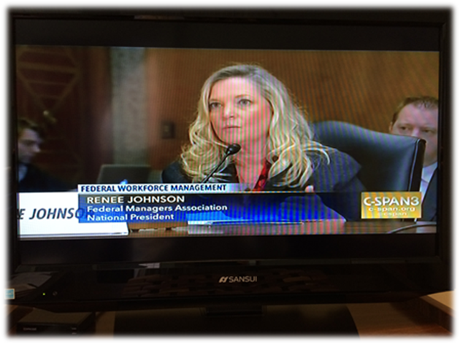
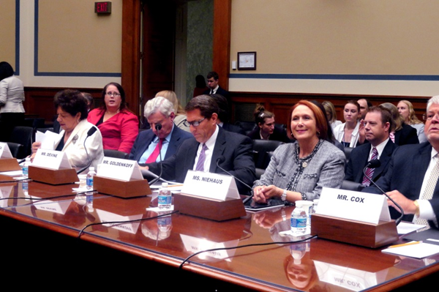
Congressional Testimony
“21st Century Ideas for the 20th Century Federal Civil Service”
Senate Committee on
Homeland Security and
Governmental Affairs
“Is the Federal Government’s General Schedule a Viable Personnel System for the Future?”
House Committee on
Oversight and Government
Reform

Slide 14
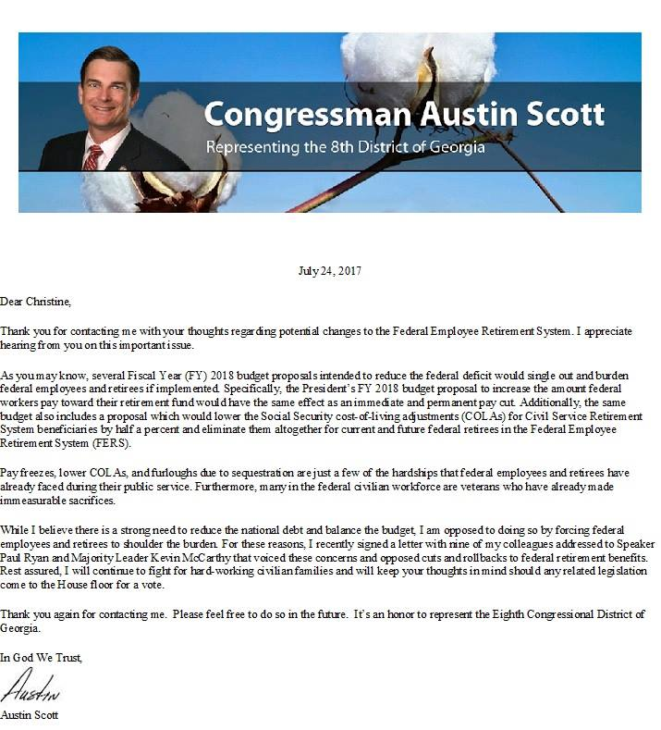
Grassroots Efforts
FMA Members Keep Informed
Washington Report & Grassroots Newsletter
Chapter Meetings
Facebook/Website
Resources and Links
FMA Staff participate in Chapter Meetings
FMA Members Get Involved
Action Letters – Update Non-Governmental Email!
FMA-PAC
In-District Meetings/Meetings with Command
Notes:
Hatch Act!

Slide 15
FMA Publications
Washington Report
FMA Grassroots Update
Monthly e-newsletter
Updates you on legislative hot button issues and FMA actions on Capitol Hill
Includes information on matters that affect your career: a must have for feds!
Monthly e-newsletter to help you learn more about the issues FMA is working on, and the many ways you can help, such as writing action letters
Sent to members’ non-govt. email addresses

Slide 16
FMA Publications
The Federal Manager
Quarterly e-magazine delivered by email and always available at www.fedmanagers.org
Features articles on FMA efforts,
various agencies’ leadership
initiatives, member and chapter
activities, retirement and
legal information

Slide 17
Member Benefits
Shaw, Bransford & Roth
Free consultations and discounted legal services
Retail Benefits Program
Cash back on purchases from over 5,000 merchants such as Best Buy, Target and Travelocity!
Travel Discounts
Worldwide Hotel Discount Program –10-20%, up to 50% discounts on hotels
Financial Advice
GPIS offers feds tools and education to plan for their financial future
Healthcare
American Hearing Benefits – Discounts on hearing aids for you and family members; free annual hearing
Insurance Offerings
Long Term Care Insurance to prepare for your future
FEDS Professional Liability Insurance is a must have for federal managers
Notes:
All these in the interest to give our membership a reason to be an FMA member. The web site has a breakdown and description of all membership benefits
National President is a guest 4 to 6 times a year on Local DC talk radio.

Slide 18
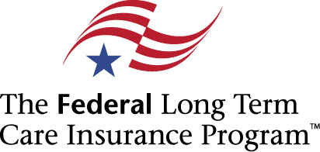
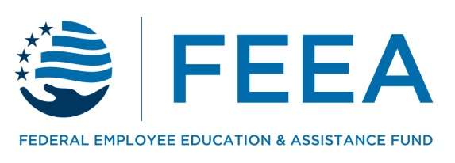
Member Benefits
FMA-FEEA Scholarship
Awarding academic scholarships to deserving candidates – FMA members and their dependents are eligible!
FEEA Emergency Assistance
Financial help for you and your employees
Donate through CFC! Pledge #11185

Slide 19
Federal Managers Association
Advocating excellence in public service
since 1913!
Visit us online:
www.fedmanagers.org
Facebook
twitter
Notes:
If you look at the web site it tells all FMA activity. Hot button issues appear on the home page. Ongoing legislative issues appear in the legislative section. The Washington Report details all current legislation along with statements made by FMA National President or Legislative Director.

