Slide 1
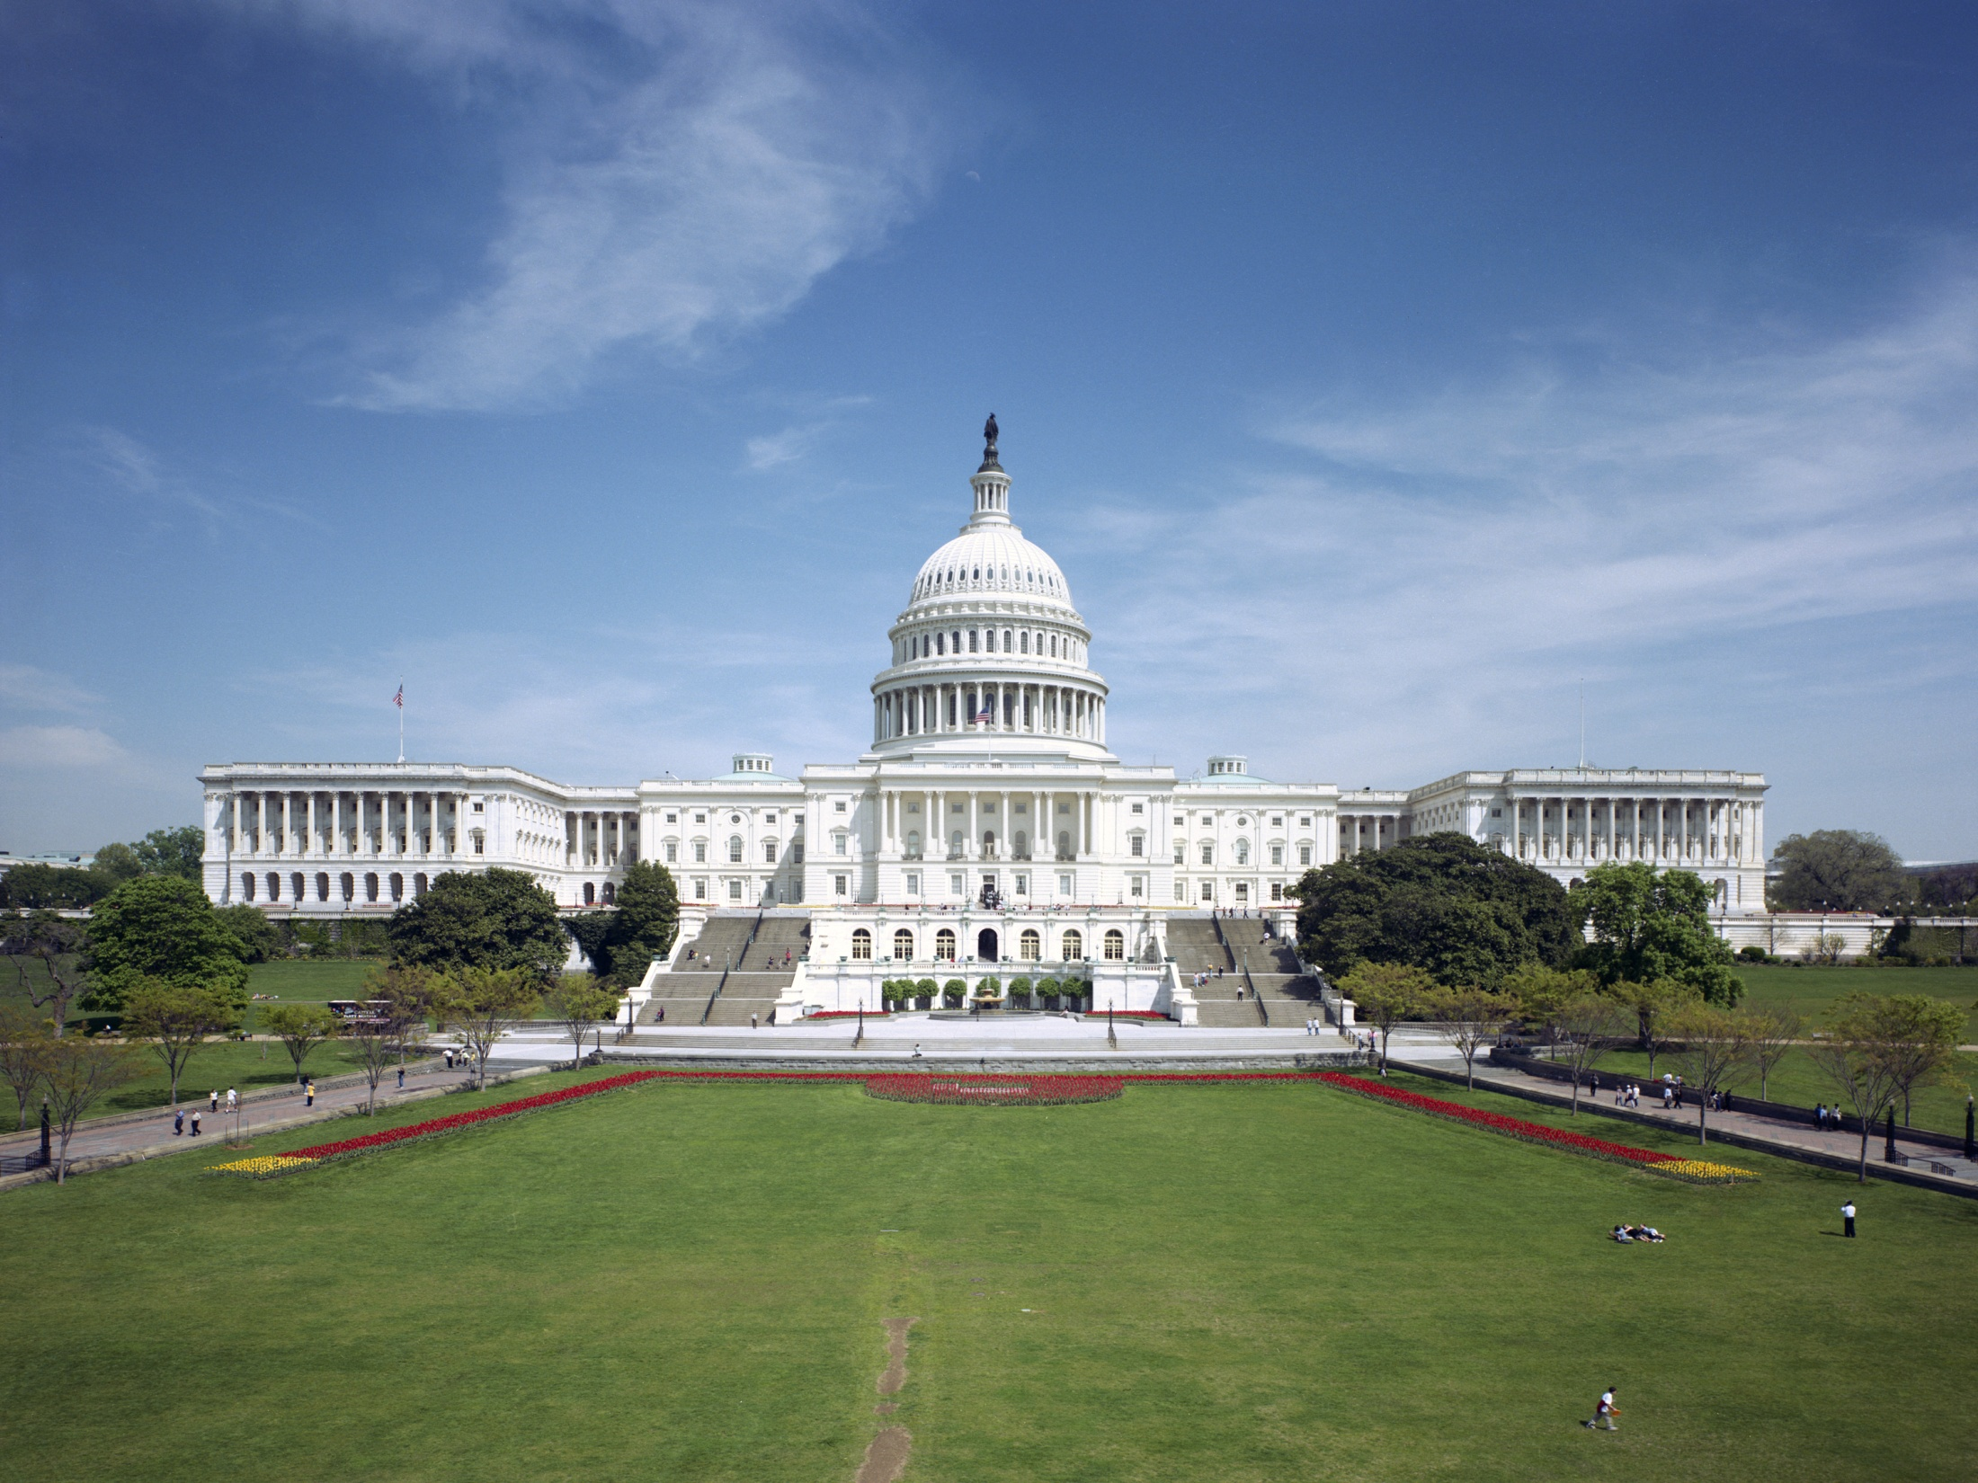

FEDERAL MANAGERS ASSOCIATION

Slide 2

Federal Managers Association
Purpose:
To Advocate Excellence in Public Service
FMA represents the interests of the more than 200,000 managers, supervisors, and executives serving in more than 40 agencies of
today’s federal government.
Notes:
While membership is 10,000 we represent some 200,000 federal managers in public services.
We are structured in 8 geographical zones
We have an office in Alexandria, VA
Staff includes Director of Marketing and Recruitment
Legislative Director, Assistant to the Legislative Director and Grass Roots Coordinator
Membership coordinator and an Administrative Assistant.

Slide 3

Mission & Vision
Mission
Vision
FMA advocates excellence in public service through effective management and professionalism, as well as the active representation of its members' interests and concerns.
FMA advances its mission through consultation in the Executive Branch and advocacy in Congress, top-notch professional development programs, informative publications and networking opportunities for its members.

Slide 4
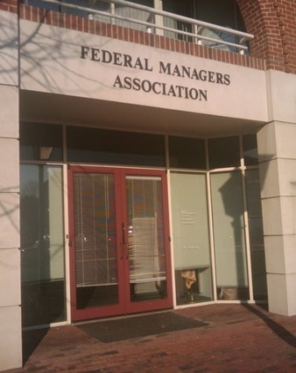
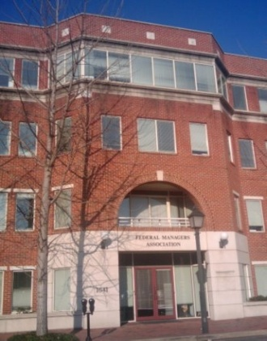
National Office
The FMA National Office is located in Alexandria, Virginia, near the King Street Metro Station and Reagan National Airport.
FMA National Office:
1641 Prince Street
Alexandria, VA 22314
703-683-8700

Slide 5
Executive Board
President: Craig Carter
Vice President: Ron Gryga
Treasurer: Christine Parker
Secretary: Chris Lombardi
Region 1 Director: Jeremy Barton, Sr.
Region 2 Director: Jason Rossman
Region 3 Director: Peggy Hatcher
Region 4 Director: Vincent Stamper

Slide 6
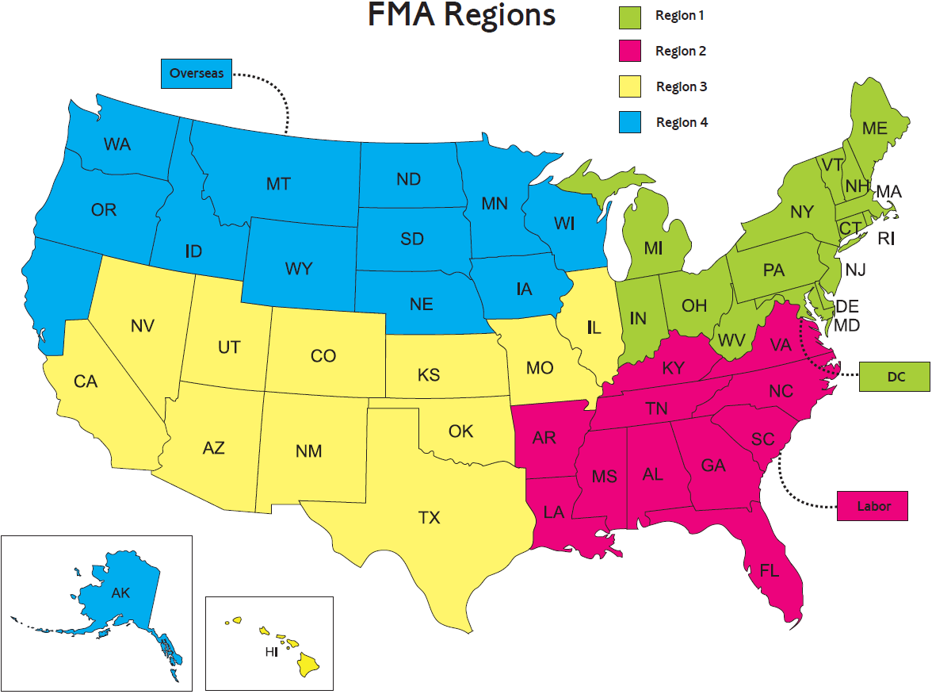

Slide 7



Advocacy in DC
Meet with Members of Congress and their Staffs
Attend hearings that affect federal managers
Meet with leaders of government agencies to influence policy
Work with other federal advocacy groups to strengthen our voice

Slide 8
Representation/Partnerships
Seat on the Employee Thrift Advisory Council (ETAC)
Government Managers Coalition (GMC)
Federal-Postal Coalition (FPC)
Federal Employee Education & Assistance Fund (FEEA)
National Active and Retired Federal Employees (NARFE)
Public Service Recognition Week Council (PSRW)
National Commission on the Public Service
National Academy of Public Administration (NAPA)
Young Government Leaders (YGL)
FMA maintains ongoing dialogue with: U.S. Office of Personnel Management (OPM) and the White House Office of Management and Budget (OMB)

Slide 9
Legislative Accomplishments
Pay Raise: Advocated for, and helped push through, President Biden’s proposed 4.6 percent federal employee pay raise for 2023. This is the highest raise for feds in 20 years!
FERS Sick Leave Credit: Those enrolled in the Federal Employees Retirement System (FERS) receive an average of at least $500 a year for applying unused sick leave towards their retirement plan. FMA was the driving force behind this legislation that rewards feds for responsible use of leave.
Repeal of DOD Cuts to Long-Term TDY Per Diems: FMA worked tirelessly for nearly four years to repeal drastic cuts of as much as 45 percent to Department of Defense (DOD) long-term TDY per diems. As a result of our efforts, DOD may no longer reduce the employee per diem allowance based on the duration of the TDY assignment.
Preventing Cuts to Benefits: FMA stopped harmful proposals in Congress’ budget request that would have increased pension contributions for existing federal employees, eliminated the FERS COLA, reduced the CSRS COLA, shifted from the “High 3” to a “High 5,” or eliminated the FERS annuity supplement.
New Locality Pay Areas: FMA advocated for the designation of six new locality pay areas beginning in 2019. These designations positively impact nearly 72,000 employees in Birmingham, Alabama; Burlington, Vermont; Corpus Christi, Texas; Omaha, Nebraska; San Antonio, Texas; and, Virginia Beach/Norfolk, Virginia.

Slide 10
Legislative Accomplishments
Paid Parental Leave: FMA supported the successful effort to provide 12 weeks of paid parental leave for new mothers and fathers (by birth, adoption, or foster) of a child. Legislation included in the FY 2020 National Defense Authorization Act (NDAA).
Wounded Warriors Federal Leave Act: Thanks to FMA, new feds with a service-connected disability will begin their career with 104 hours of additional sick leave to use for their disability-related appointments and treatment during their first year as federal employees. In addition to the legislative action, FMA worked with rule makers at the Office of Personnel Management (OPM) who drafted exemplary rules for implementation.
Allowing Feds in Reserves an opportunity to enroll in the health plan of choice: FMA advocated for the TRICARE Reserve Select Improvement Act, which allows feds in the reserves or National Guard to enroll in this plan, like their non-fed counterparts, if they choose. Language included in the FY 2020 NDAA.
Locality Pay Extension: Federal employees in Alaska, Hawaii, and U.S. Territories now receive locality pay. Thanks to work done by FMA local chapters in Hawaii, the legislation signed into law closely mirrored FMA’s proposal.

Slide 11
Legislative Accomplishments
FEHBP Self Plus One: In the Bipartisan Budget Plan (P.L. 113-67), Members of Congress called for the Office of Personnel Management to offer a “Self Plus One” option to federal employees enrolled in the Federal Employees Health Benefits Program (FEHBP). FMA long advocated for this option, as it would immediately reduce federal spending and provide affordable health care to couples or single parents with one child.
Combat Zone Allowances, Benefits, and Gratuities for Civilian Personnel: FMA supported the extension of this authority through 2020.
Disabled Veteran Leave Extension to FAA and VA: FMA worked with legislators in the House and Senate to extend eligibility for disabled veteran leave to Title 49 employees (Federal Aviation Administration) and Title 38 (Veterans Affairs) employees.
Phased Retirement: Employees who are retirement-eligible now have the choice of switching to part-time work, drawing a partial salary and a partial annuity, both prorated according to the time worked.
Reemployed Annuitants Legislation: FMA’s efforts were crucial to the passage of legislation that allows retired feds to return to service part-time without offsetting their annuities.

Slide 12
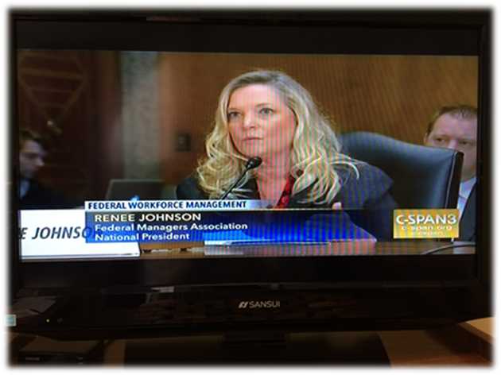
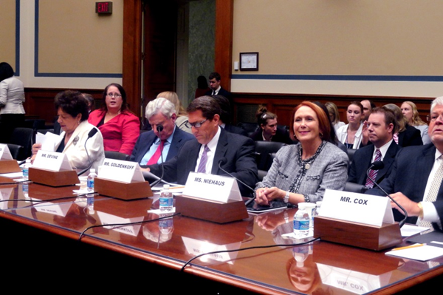
Congressional Testimony
“21st Century Ideas for the 20th Century Federal Civil Service”
Senate Committee on
Homeland Security and
Governmental Affairs
“Is the Federal Government’s General Schedule a Viable Personnel System for the Future?”
House Committee on
Oversight and Government
Reform

Slide 13
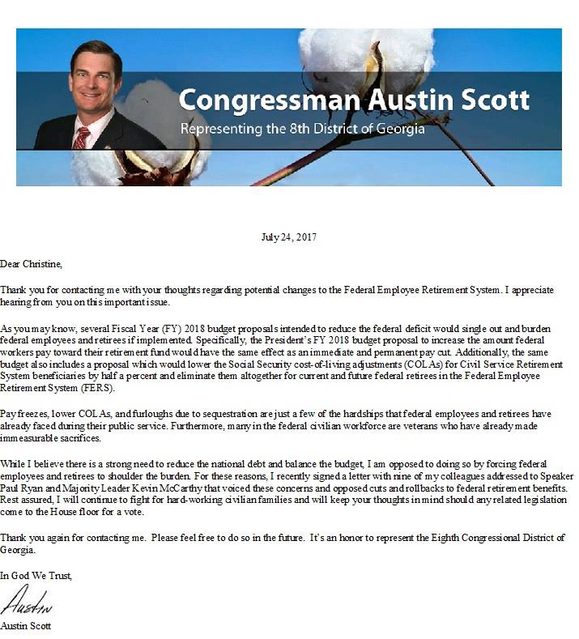

Grassroots Efforts
FMA Members Keep Informed
  Washington Report & Grassroots Newsletter
  Chapter Meetings
  Facebook/Website
    Resources and Links
  FMA Staff participate in Chapter Meetings
FMA Members Get Involved
  Action Letters – Update Non-Governmental Email!
  FMA-PAC
  In-District Meetings/Meetings with Command
Notes:
Hatch Act!

Slide 14
FMA Publications
Washington Report
FMA Grassroots Update
Monthly e-newsletter
Updates you on legislative hot button issues and FMA actions on Capitol Hill
Includes information on matters that affect your career: a must have for feds!
Monthly e-newsletter to help you learn more about the issues FMA is working on, and the many ways you can help, such as writing action letters
Sent to members’ non-govt. email addresses

Slide 15
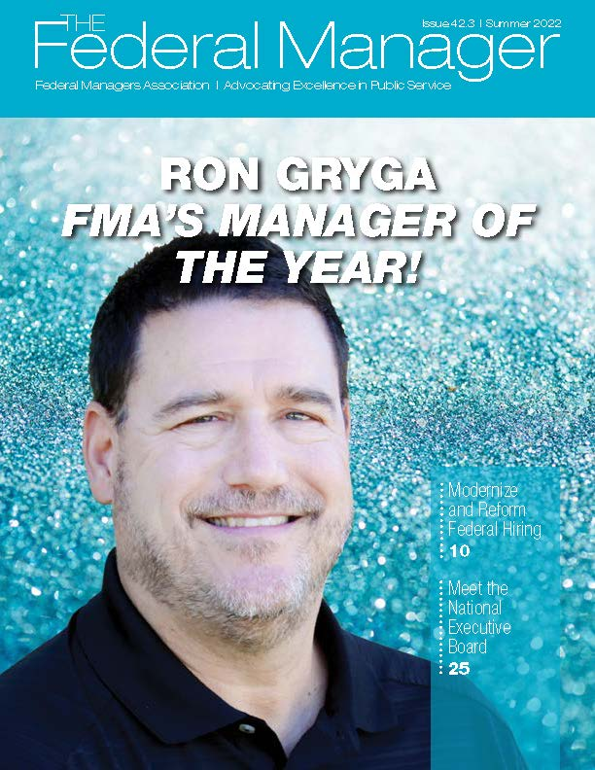
FMA Publications
The Federal Manager
Quarterly magazine delivered by email and always available at www.fedmanagers.org

Slide 16
Member Benefits
Shaw, Bransford & Roth
  Free consultations and discounted legal services
Retail Benefits Program
  Cash back on purchases from over 5,000 merchants such as Best Buy, Target and Travelocity!
Travel Discounts
  Worldwide Hotel Discount Program –10-20%, up to 50% discounts on hotels
Financial Advice
  GPIS offers feds tools and education to plan for their financial future
Healthcare
  Start Hearing – Free or discounted hearing aids for you and family members
Insurance Offerings
  Long Term Care Insurance to prepare for your future
  FEDS Professional Liability Insurance is a must have for federal managers
Notes:
All these in the interest to give our membership a reason to be an FMA member. The web site has a breakdown and description of all membership benefits
National President is a guest 4 to 6 times a year on Local DC talk radio.

Slide 17







Member Benefits
FMA-FEEA Scholarship
  Awarding academic scholarships to deserving candidates – FMA members and their dependents are eligible!
FEEA Emergency Assistance
  Financial help for you and your employees
  Donate through CFC! Pledge #11185

Slide 18

Federal Managers Association
Advocating excellence in public service since 1913!
Visit us online:
www.fedmanagers.org
Facebook
twitter
Notes:
If you look at the web site it tells all FMA activity. Hot button issues appear on the home page. Ongoing legislative issues appear in the legislative section. The Washington Report details all current legislation along with statements made by FMA National President or Legislative Director.

